Slide 1
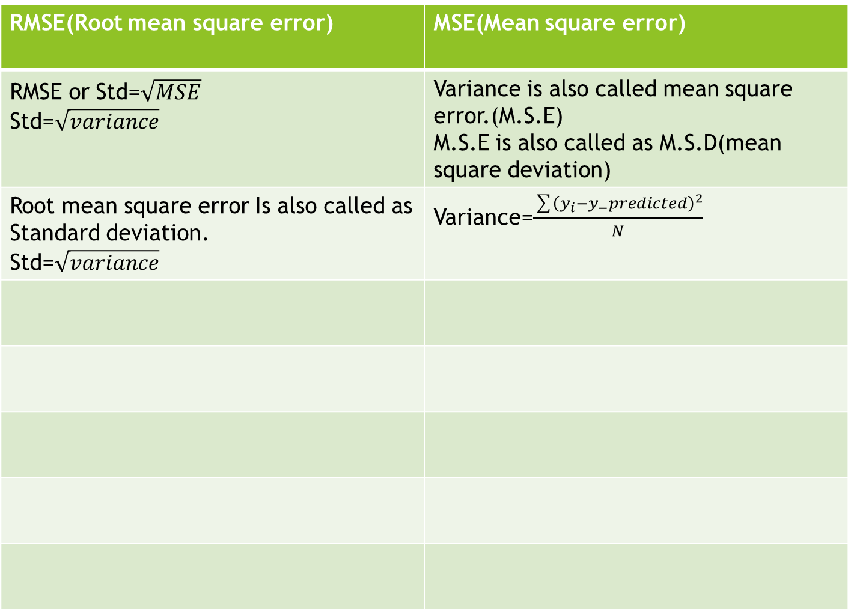
Difference b/w RMSE & MSE
RMSE(Root mean square error) | MSE(Mean square error)
RMSE or Std=$\sqrt{MSE}$ Std=$\sqrt{variance}$ | Variance is also called mean square error.(M.S.E) M.S.E is also called as M.S.D(mean square deviation)
Root mean square error Is also called as Standard deviation. Std=$\sqrt{variance}$ | Variance=$\frac{\sum{{\left(y_{i}−y_{−}predicted\right)}^{2}}}{N}$

Slide 2
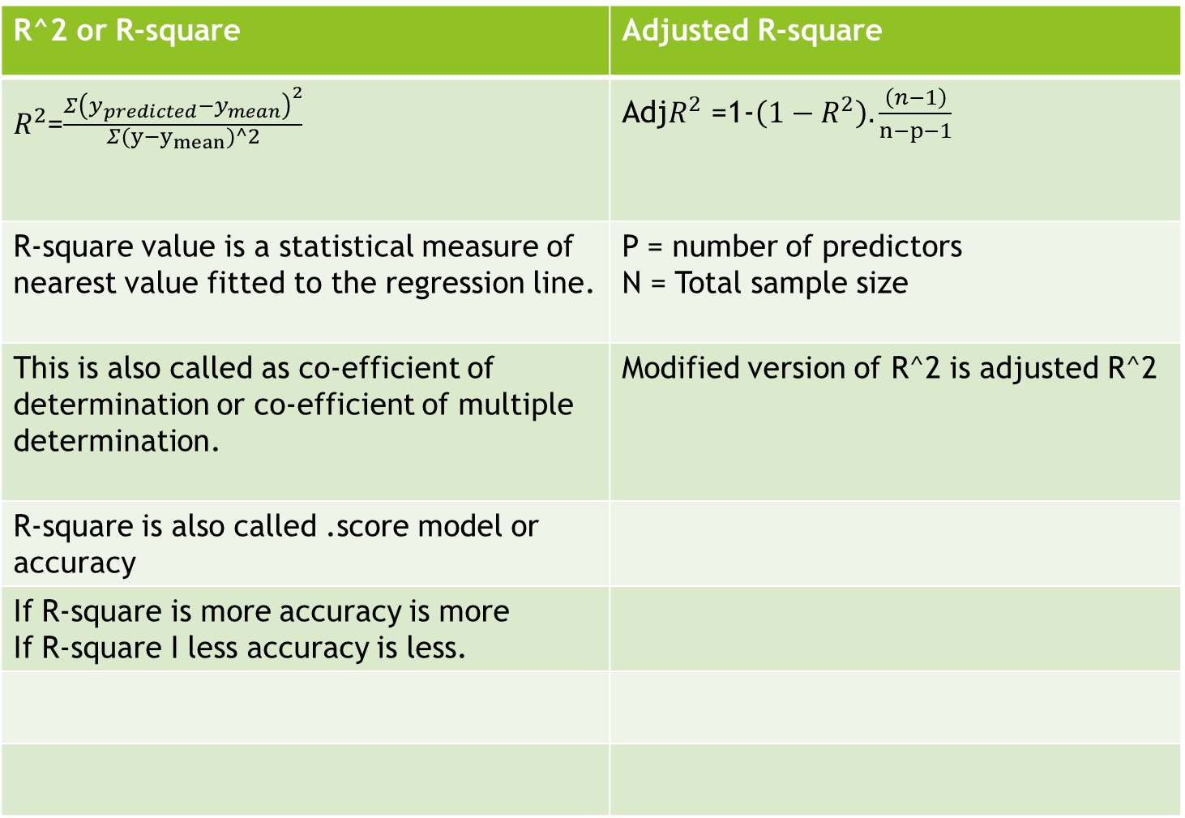
R^2 & adjusted R^2
R^2 or R-square | Adjusted R-square
$R^{2}$=$\frac{Σ{\left(y_{predicted}−y_{mean}\right)}^{2}}{\begin{aligned}Σ(y−y_{mean})^2 \\ \end{aligned}}$ | Adj$R^{2}$ =1-$\left(1−R^{2}\right).\frac{\left(n−1\right)}{n−p−1}$
R-square value is a statistical measure of nearest value fitted to the regression line. | P = number of predictors N = Total sample size
This is also called as co-efficient of determination or co-efficient of multiple determination. | Modified version of R^2 is adjusted R^2
R-square is also called .score model or accuracy
If R-square is more accuracy is more If R-square I less accuracy is less.

Slide 3
outlier
An outlier is an object that derivates significantly from the rest of the objects. They can be caused by measurement or execution error. The analysis of outlier data is referred to as outlier analysis or outliner mining.

